Slide 1
AMEND – Machine Learning
Shreyas Mhasawade
Tyler Cole
Adrija Bhattacharya
Mikias Balkew
Chris Rothmann

Slide 2
Executive Summary
Main Goal: Track satellites to maximize Gain-to-Noise
Develop controls to physically move ground dishes to point in proper direction
Now implementing with machine learning techniques based on simulation databases
Normally controls are done with traditionally calibrated PID systems

Slide 3
Logistical Background
Project is created by and done for VIASAT
Ongoing project built on previous team's work
Split into two teams: Hardware & Machine Learning

Slide 4
Project Description
We want to design and implement a ML algorithm to accept a wide range of RF inputs and generate PID parameters to take predictive actions.
The goal is to create increasingly accurate PID parameters that produce improved corrective actions for the tracking system.

Slide 5
Main steps to take:
Create Matlab database that will hold data points generated from the existing RF model
Develop method of extracting data from the RF model
Implement a way to transfer this data into the ML algorithm

Slide 6
Technical Specifications

Slide 7
Design Approach

Slide 8
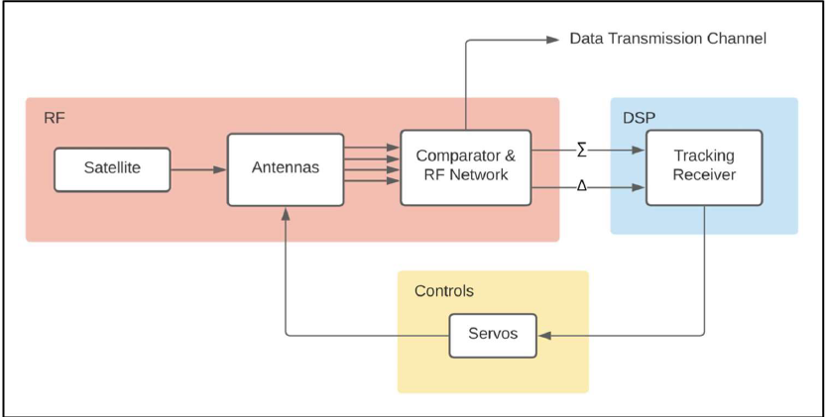
Existing Infrastructure
Matlab/Simulink model that simulates dynamic response of antenna tracking system in time domain
Model will be used to reliably generate data that can be used to train the ML algorithm
Work will be in close conjunction with AMEND Analog team
Analog team will focus on improving model to add features that will yield more accurate data
Block diagram for existing RF model
Notes:
This is actually a continuation of a previous AMEND team, and what they produced during their time on the project was a Matlab/Simulink model that simulates the functionality of the antenna tracking system. So in the real world, the tracking system would receive some input data and would output some output data on how the antenna needs to be adjusted.
Having this model as a resource means that we can generate data points on how the tracking system would respond given certain inputs. As a result, we wouldn't need to request large amounts of data from Viasat and see if it works for us, we can generate the points in house.
We will need to carefully select realistic input parameters for a variety of scenarios that will create useful data for us. The more representative of the real world the scenarios, the more accurate the output we will receive from the model.
We are also working in conjunction with an analog AMEND team. They will be working on increasing the fidelity of the current model, adding capabilities with other real world factors like noise. With the analog team working to make improvements to the model, we can be confident that our base data set will be strong.

Slide 9
Ideation and Tradeoffs
Solution will be implemented within MATLAB/Simulink using its native toolbox
Implementing solution within MATLAB toolbox is not computationally ideal
There are two primary “blocks” within the project
Database populated by the existing RF model
ML algorithm that outputs improved PID controller parameters
Notes:
We will utilize the Matlab Statistics and Machine Learning toolbox in order to stay within the existing model's environment [3]. Our project will exist as a separate entity from the existing model, but it will take inputs from and feed outputs back into the existing model.
It will be easier to synchronize it with the data that is being generated from the RF model, since it is all in matlab. The algorithm will not be as quick as it could be if implemented in a different environment, but it will allow viasat engineers to navigate through the tool more easily, allowing for future opportunity for improvement.
The first block will be a database that is populated by outputs from the existing RF model. We will have to create “scenarios” that can be used to generate model data. In other words, we will select certain input parameters, and get some outputs from the RF models using these input parameters. These outputs will then be placed within the database.
The second block will be where the machine learning techniques are utilized. The second block will take as input, the data points that were generated and stored within the database. Using these initial values, the ML algorithm implemented within the second block will generate improved PID parameters.

Slide 10
Engineering Analyses and Experiment
Expensive ground stations – current PID parameters shall be compared to historical PID parameters from Viasat.
Will utilize previous test scenarios as a means of quantifying the effectiveness of the ML algorithm.
RF model – Input Parameters – ML Algorithm – PID Parameters Outputted
Quantity of interest for algorithm testing – root mean squared error of updated PID parameters
Notes:
We have been provided with both a tool that will yield us measurements that would be too difficult to acquire otherwise, and a team that will work to improve the measurements given to us by the existing tool.
The design system for the database will rely heavily on receiving data from the existing RF model. We will need to carefully select realistic input parameters that will create good data points to be stored within the database.
The more representative of the real world the scenarios, the more accurate the output we will receive from the model. With the analog team working to make improvements to the model, we can be confident that our base data set will be strong..
If we did not have access to this tool, we would need to acquire Viasat’s historical data of how the reestablished communication between ground stations and satellites

Slide 11
Codes and Standards
1st regulation to consider – FCC standard 15.209 – intentional emissions of RF energy.
- The design model of the tracking system should not radiate RF energy, unless done so unintentionally due to non-idealities associated with the system. That said, it is unlikely that this regulation should affect the design.
2nd regulation to consider – FCC part 25 – carrier frequency tolerance, power radiation, frequencies incorporated into design, and antenna (ground station) angle of elevation.
Notes:
We have been provided with both a tool that will yield us measurements that would be too difficult to acquire otherwise, and a team that will work to improve the measurements given to us by the existing tool.
The design system for the database will rely heavily on receiving data from the existing RF model. We will need to carefully select realistic input parameters that will create good data points to be stored within the database.
The more representative of the real world the scenarios, the more accurate the output we will receive from the model. With the analog team working to make improvements to the model, we can be confident that our base data set will be strong..
If we did not have access to this tool, we would need to acquire Viasat’s historical data of how the reestablished communication between ground stations and satellites

Slide 12
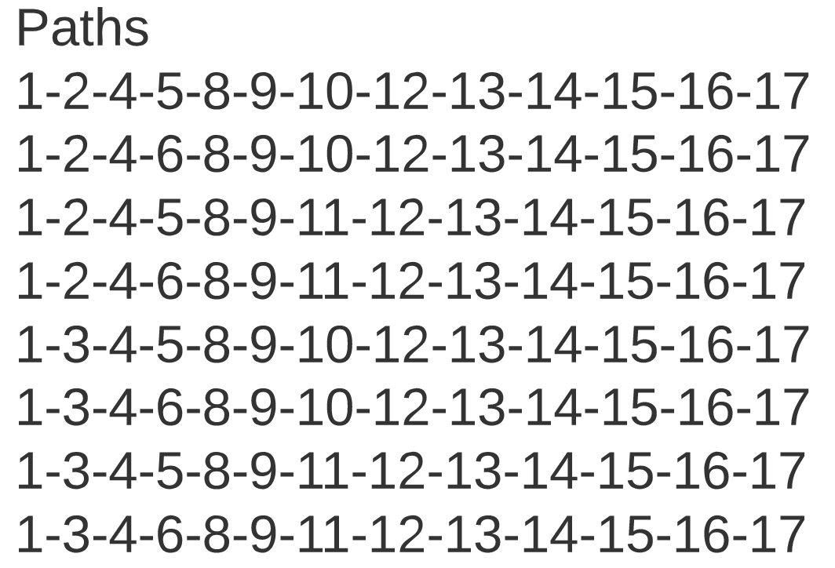
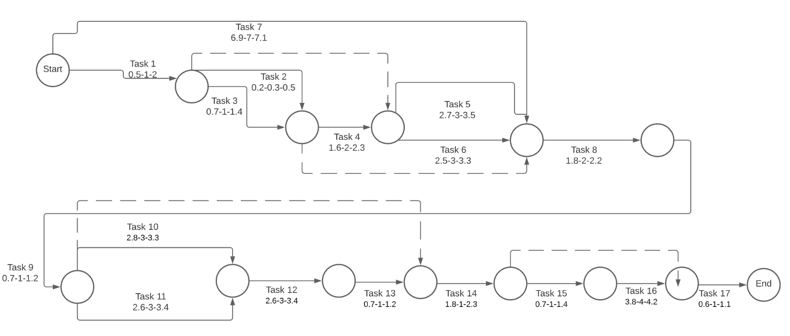
Schedule
Critical Path:
1-3-4-5-8-9-10-12-13-14-15-16-17
PERT Chart
Expected duration of the project: 23.09 weeks
Expected standard deviation for the critical path: .414
Probability of finishing project one week prior to design expo: 99.99999999987202 %

Slide 13
Marketing and Cost Analysis
Given the project is internal to Viasat, there are no competitors to be aware of. The closest we have is a previous iteration of the AMEND project’s model to further build upon.
Estimated Program Cost = $31,020 * 3 = $93,060
Our estimated program cost utilizes the “Rule of Three” that we were given, which accounts for all costs supplementary to our labor cost.
With the minimal physical materials needed from the project, cost of labor is as follows:
First Semester - 12 weeks | Total Number of Hours | Cost
Assignment Completion | 24 | $1,056
Industry Sponsor Meetings | 6 | $264
Faculty Advisor Meetings | 6 | $264
Second Semester - 15 weeks
Coding/Engineering | 90 | $3960
Industry Sponsor Meetings | 7.5 | $330
Faculty Advisor Meetings | 7.5 | $330
 | Total Labor Cost per Engineer | $6,204
 | Total Labor Cost for 5 Engineers on Team | $31,020

Slide 14
Division of Labor
Our team roles have been divided in the following manner:
Webmaster/ Git Coordinator – Tyler Cole
RF Insider – Mikias Balkew
Documentation/Viasat Coordinator - Shreyas Mhasawade
DSP insider - Adrija Bhattacharya
Expo Coordinator - Chris Rothmann

Slide 15
Division of Labor Cont. - Individual Roles
Real time ML
ML for servo control
Satellite infrastructure
Calibration with ML
Antenna Parameters

