Slide 1
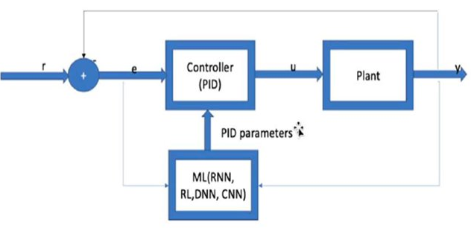
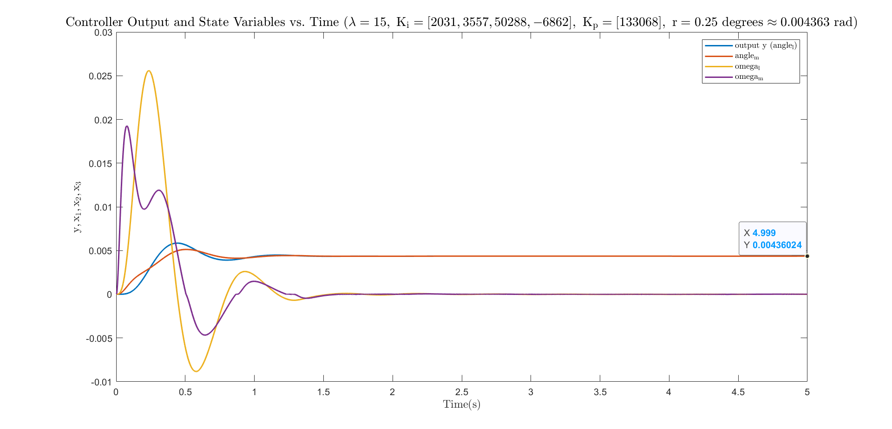
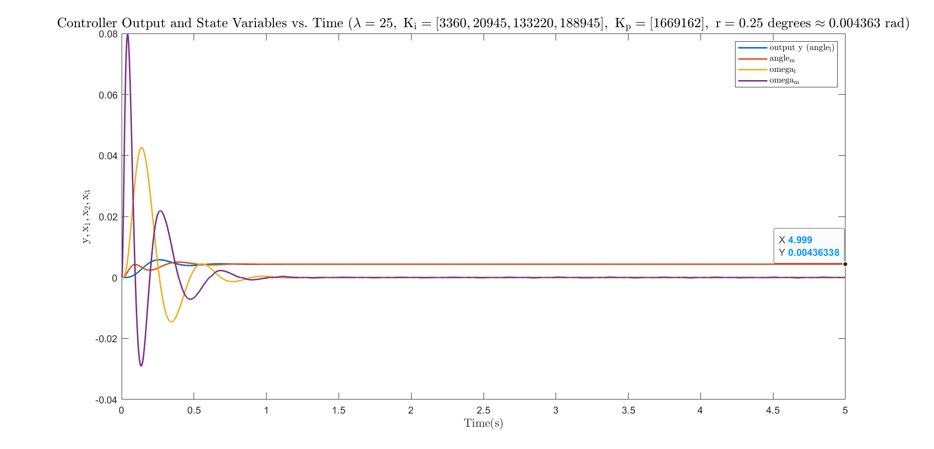
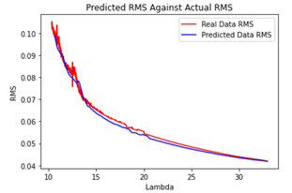
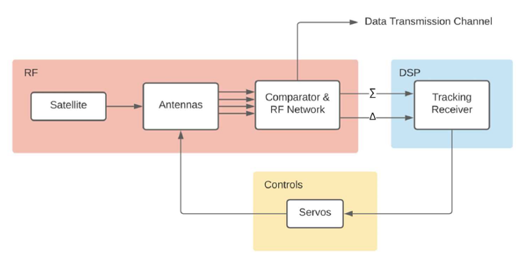
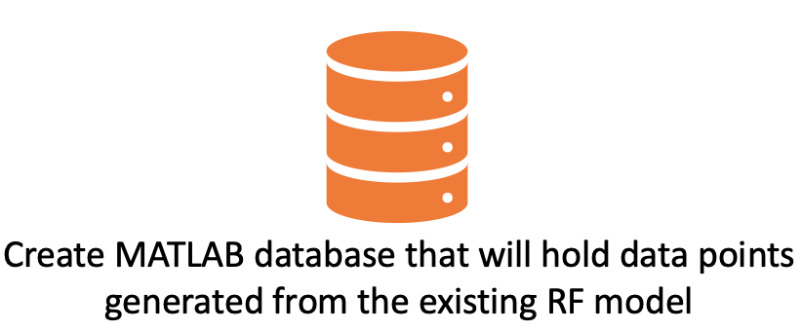
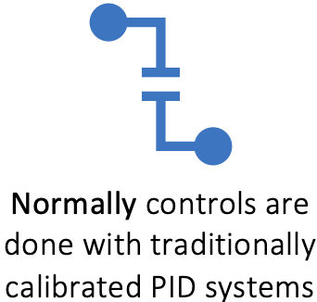
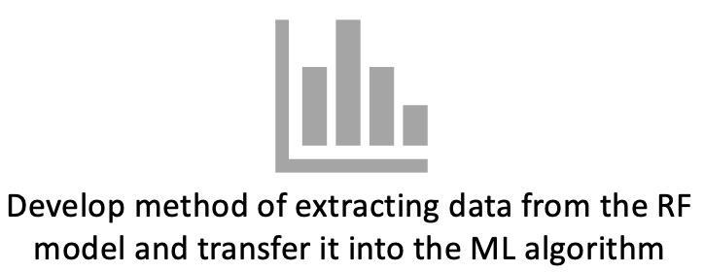
Auto-track Model with Error and Noise for Dishes (AMEND) Machine Learning Team
Undergraduate Team: Mikias Balkew, Adrija Bhattacharya, Tyler Cole, Shreyas Mhasawade, Chris Rothmann Faculty Advisor: Dr. Xiaoli Ma
The number of Low Earth Orbit (LEO) satellites are increasing, which requires significant investment in ground stations for communications Goal: Create a machine learning (ML) algorithm capable of generating reliable PID controller parameters for the Auto-tracking Control System designed to keep a ground station’s parabolic dish pointed at a LEO satellite at all times.
Method
Background
The existing model from last year will produce some representative data for chosen scenarios, and the data generated will create more accurate inputs for the PID controller by using machine learning techniques for analysis
RMS error incorporates both signal overshoot and damping delay in its calculation and is thus optimal for ML training
Classical control system design is used to generate control parameter data used to train the ML block
Fig 4. Graph of plant outputs as a function of time for two different lambda values
Fig 3. Block Diagram for proposed solution. The MATLAB code is used to generate data which feeds into the ML code which is run in Python
MATLAB Code
The MATLAB script is utilized to generate different K1 and K2 values based on strategic eigenvalue placement
Simulations are run with updated K1 & K2 parameters
RMS of output angle and corresponding K1 & K2 are written to training data set
RMS data serves as training data for the ML algorithm
*
Fig 5. Graph showing predicted RMS plotted against the Lambda value to demonstrate improved RMS error through the ML algorithm
Fig 2. Block Diagram for the existing RF Model
Future Work
A derivative (D) block can be added in the Simulink to create a PID controller instead of the PI used in this project for higher accuracy
A < 30% overshoot parameter can be added to the machine learning algorithm for better control
Fig 1. Viasat 7m dish
Why: Minimize the amount of time between the acquisition of satellite position data and the execution of control system protocols for corrective actions to the ground station’s servo motors, accounting for dynamic satellite data through automatic initialization of control parameters.
Python Code
The Python script trains the RNN algorithm by comparing the RMS error in the plant's output to that present in the training data
An upper limit will be placed on the RMS error as a constraint on the output Kp and Ki values
The Python code also graphs a predictive plot comparing the RMSE value of the training data against the test data
References
[1] Ziegler, J. G., and N. B. Nichols. “Optimum Settings for Automatic Controllers.” Journal of Dynamic Systems, Measurement, and Control, vol. 115, no. 2B, 1993, pp. 220–222., https://doi.org/10.1115/1.2899060.
[2] Zulu, Andrew. “Towards Explicit PID Control Tuning Using Machine Learning.” 2017 IEEE AFRICON, 2017, https://doi.org/10.1109/afrcon.2017.8095520.
[3] Davis, Zachary et al. “A Causal Model Approach to Dynamic Control.” Cognitive Science (2018): 281-286.

