Slide 1
AMEND ML
4/1/22

Slide 2
Problem Statement
Main Goal: Track satellites to maximize Gain-to-Noise
Develop controls to physically move ground dishes to point in proper direction
Now implementing with machine learning techniques based on simulation databases
Normally controls are done with traditionally calibrated PID systems

Slide 3
Project Description
We want to design and implement a ML algorithm to accept a wide range of RF inputs and generate PI parameters to take predictive actions.
The goal is to create increasingly accurate PI parameters that produce improved corrective actions for the tracking system.

Slide 4
Main steps to take:
Create training data that will hold data points generated from the existing RF model
Develop method of extracting data from the RF model
Implement ML algorithm to guess updated PID parameters

Slide 5
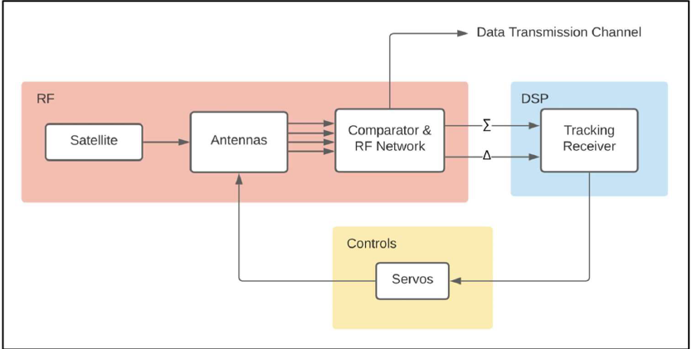
Existing Infrastructure
Matlab/Simulink model that simulates dynamic response of antenna tracking system in time domain
Model is used to reliably generate training data for the ML algorithm
Work is in close conjunction with AMEND Analog team
Analog team can at any point provide us with an updated model to generate more accurate data
Block diagram for existing RF model
Notes:
This is actually a continuation of a previous AMEND team, and what they produced during their time on the project was a Matlab/Simulink model that simulates the functionality of the antenna tracking system. So in the real world, the tracking system would receive some input data and would output some output data on how the antenna needs to be adjusted.
Having this model as a resource means that we can generate data points on how the tracking system would respond given certain inputs. As a result, we wouldn't need to request large amounts of data from Viasat and see if it works for us, we can generate the points in house.
We will need to carefully select realistic input parameters for a variety of scenarios that will create useful data for us. The more representative of the real world the scenarios, the more accurate the output we will receive from the model.
We are also working in conjunction with an analog AMEND team. They will be working on increasing the fidelity of the current model, adding capabilities with other real world factors like noise. With the analog team working to make improvements to the model, we can be confident that our base data set will be strong.

Slide 6
Ideation and Tradeoffs
Solution uses MATLAB to generate a database and uses Python libraries such as TensorFlow to run an RNN algorithm
Implementing solution within MATLAB toolbox is not computationally ideal
RNN feeds output back into MATLAB input
Got rid of D block
Notes:
We will utilize the Matlab Statistics and Machine Learning toolbox in order to stay within the existing model's environment [3]. Our project will exist as a separate entity from the existing model, but it will take inputs from and feed outputs back into the existing model.
It will be easier to synchronize it with the data that is being generated from the RF model, since it is all in matlab. The algorithm will not be as quick as it could be if implemented in a different environment, but it will allow viasat engineers to navigate through the tool more easily, allowing for future opportunity for improvement.
The first block will be a database that is populated by outputs from the existing RF model. We will have to create “scenarios” that can be used to generate model data. In other words, we will select certain input parameters, and get some outputs from the RF models using these input parameters. These outputs will then be placed within the database.
The second block will be where the machine learning techniques are utilized. The second block will take as input, the data points that were generated and stored within the database. Using these initial values, the ML algorithm implemented within the second block will generate improved PID parameters.

Slide 7
Solution Block Diagram
How fast is update?
Approximately 1 kHz for new reference satellite positions
Minutes to hours for control parameters.
Error constraint – aim to implement upper threshold on RMS error in order to systematically tune the tracking system's desired accuracy.

Slide 8
Data Generation
RMS error – incorporates both signal overshoot and damping delay in its calculation – optimal for training ML algorithm to decrease both nonidealities
Classical control system design can be used to generate controller parameter datasets used to train the ML block.

Slide 9
Data Generation
We apply variations to the eigenvalue "Lambda“
There is a direct dependence of Kp and Ki on this parameter.
We generate different errors, outputs, Kp and Ki's, and RMS errors.
Relationship between Kp, Ki, and Lambda

Slide 10
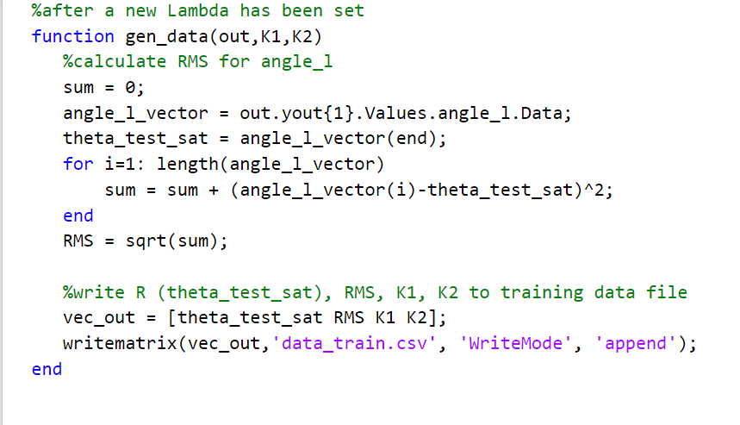
Data Generation Code
Chooses different Lambda values to generate new K1 and K2 values
Runs simulation with updated K1 and K2
Writes RMS of output angle, as well as corresponding K1 & K2 to training data

Slide 11
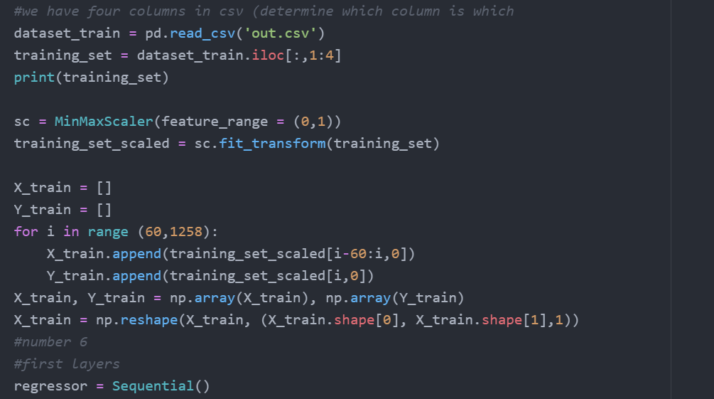
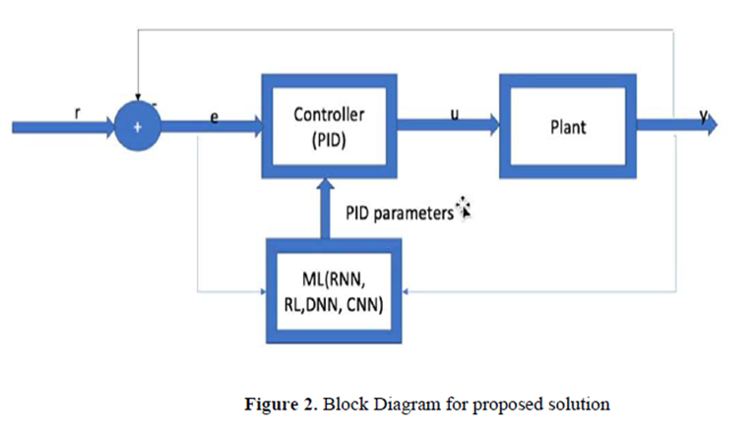
Python script generating Kp, Ki
Goal: Take in the output of the model as input (angle_m, angle_l, wm, wl) and output Kp and Ki.
The script will train the RNN algorithm by comparing the RMS error in the plant's output to those present in the list of training data. An upper limit can be placed on the RMS error as a constraint on the output Kp and Ki values.
The training data comprises of angle_l RMSE, K1, K2, reference angle (r), and Lambda.
Chooses ideal K1 and K2.

Slide 12
Current RNN code​
We set up RNN skeleton code that imports desired libraries
Code uses “out.csv” as input and pulls data out to be the training set
10000 step time series for angle_l, angle_m, wm, wl
The Machine Learning block shall be utilized to optimize this position correction process by setting a threshold RMS error as an upper limit on the accepted amount of error that can be tolerated by the control system.
We can use the updated plant from the hardware team.

Slide 13
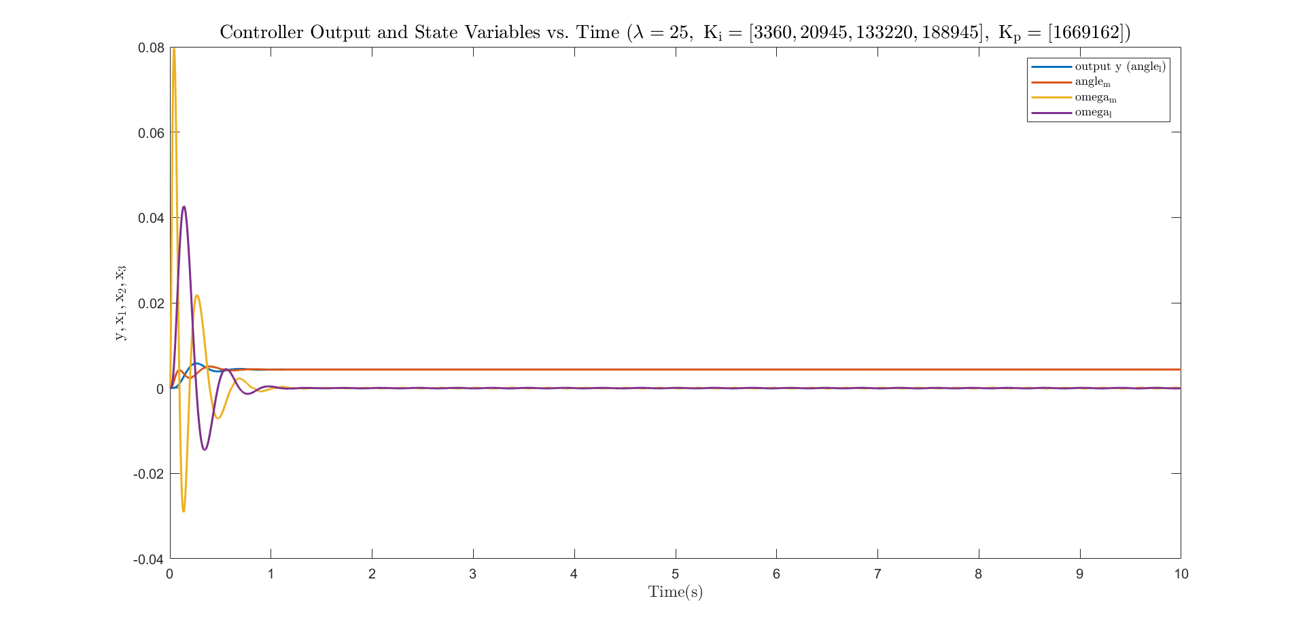
Plant Output vs Time

Slide 14
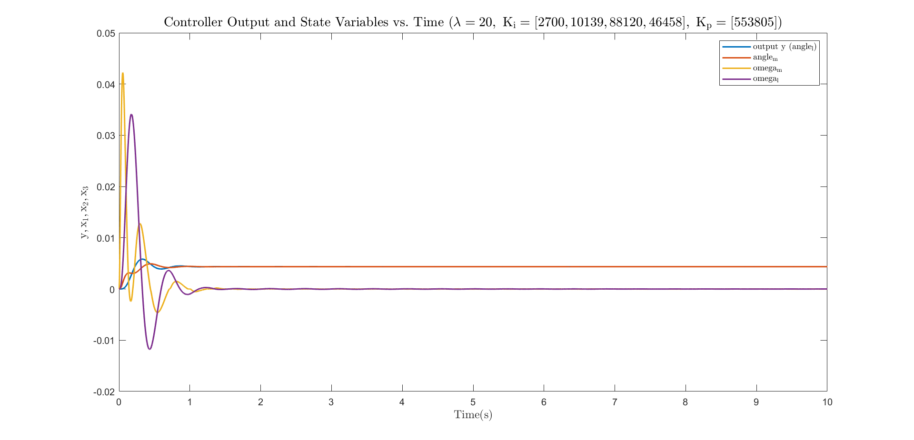
Plant Output vs Time

Slide 15
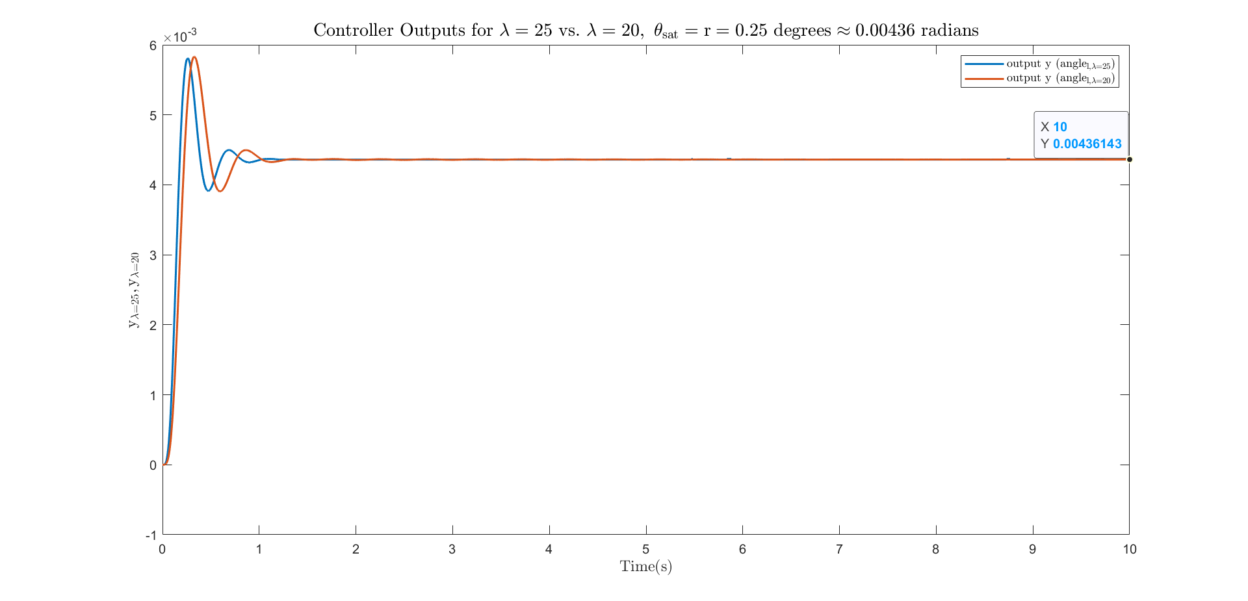
Plant Output vs Time

Slide 16
Questions?

