Slide 1
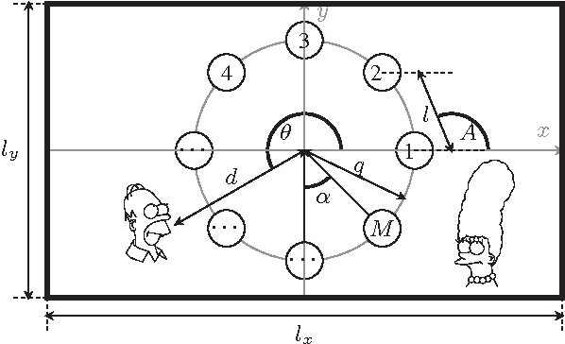
Acoustic Source Localization
By: Tiffany Ho, Ajeetpal Dhillon, Harry Nguyen, Andrew Dulaney, Daniel Scarborough, Sidong Guo

Slide 2
Introduction
Objective
  To identify the location of a sound source in a given area
Motivation
  We would like to make an alternated detection method that offer an alternative approach to video detection.
Background
  Different Methods
    Time of arrival
    Time difference of arrival
    Receiver signal strength

Slide 3
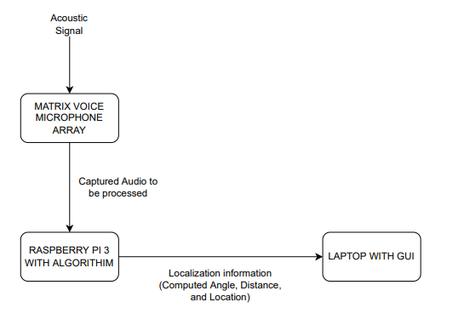
Project Description
Localization Software for Acoustic Signals
Motivation
  Applications in Emergency Rescue, child and elderly care
TDOA for Angle
Signal Strength for Distance

Slide 4
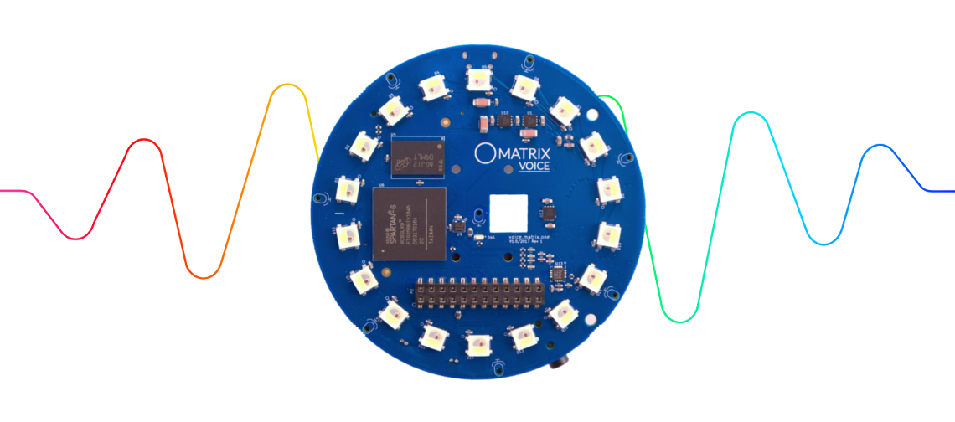
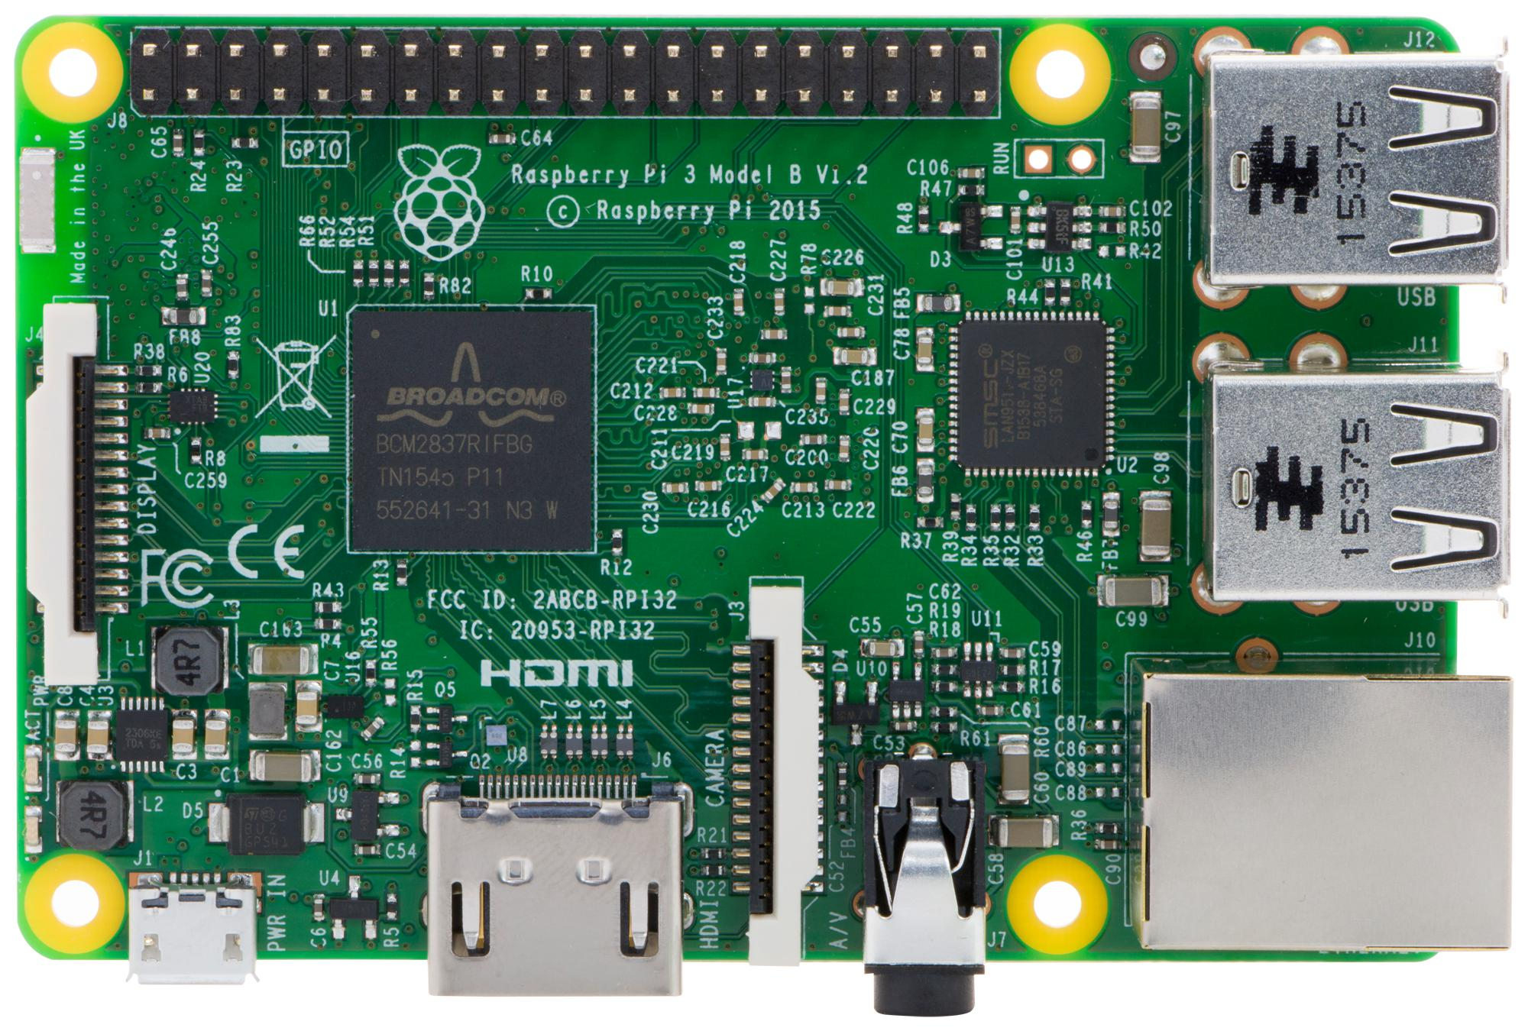
Design Details
MATRIX VOICE
  Circular 8 Mic Array
RASPBERRY PI 3

Slide 5
Raspberry Pi and Matrix Setup
Two functioning Matrix modules each with a Pi
Pi's can be 3 or 4
  Buster OS
  Matrix HAL Library
Localization.py
  Runs recording executable via subprocess
  Converts .raw files to .wav
  Begins localization algorithm

Slide 6
Design Specification
Parameters | Specifications
Audio Specification | 8-96 kHz
Bit Depth | Signed 16 bits
Operation Range | 20 meters
Cost | Below $200
Angle Accuracy | Average difference within 3 degrees
Distance Accuracy | Average difference within 30 centimeters
Processing Delay | Average processing delay within half second

Slide 7
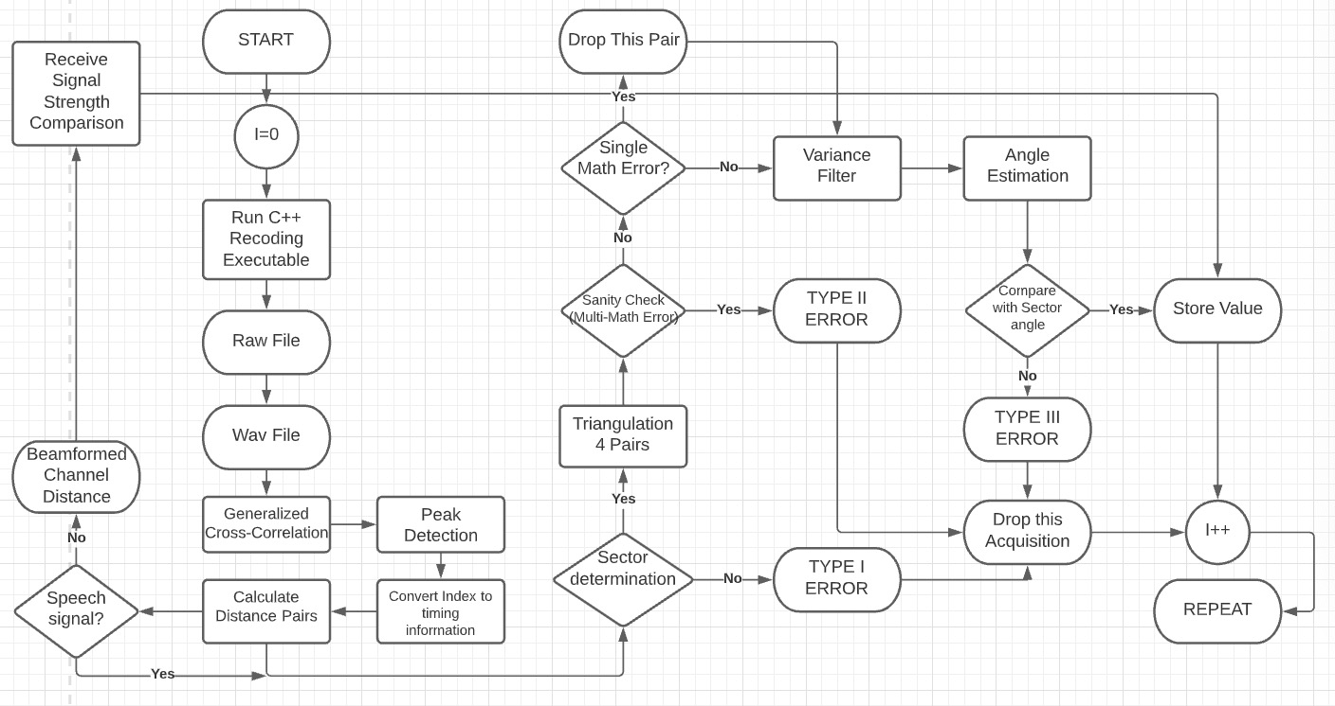
Design Approach-Algorithm

Slide 8
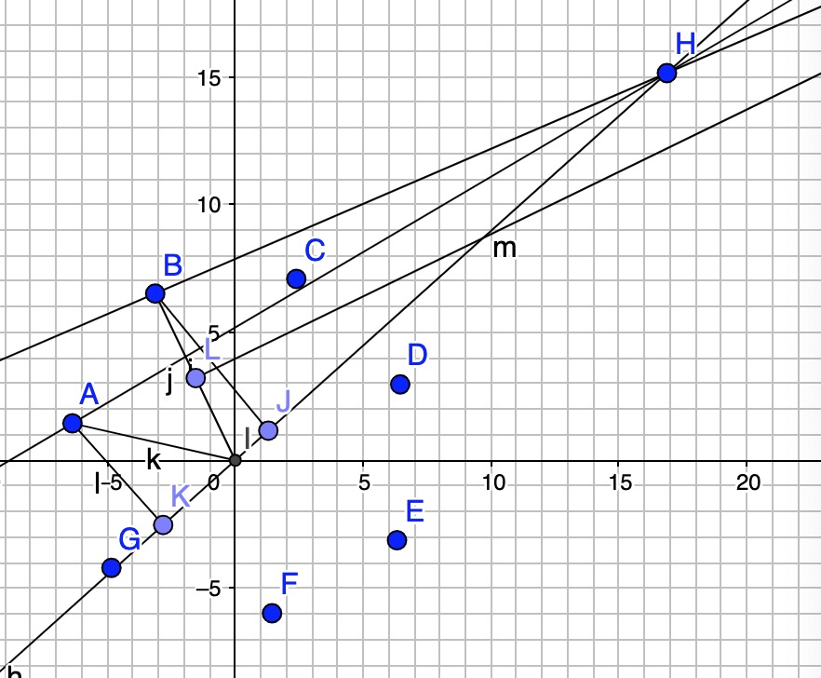
Angle Calculation
1. Uses Pesudo Far-field Assumption
2. Average over multiple angle estimation
3. Uses an outlier filter to enhance stability
4. Uses decision-feedback to perform error correction

Slide 9
Comparison to other methods
ODAS (Open Embedded Audio System)
Gillete-Silverman Algorithm
Far-field Algorithm
Closed-form approach
MUSIC (Multiple Signal Classification)
ODAS' probabilistic approach
Prediction->Likelihood (Prior and Posterior probability)->add and remove sources-> update.
Tracking and Multi-source

Slide 10
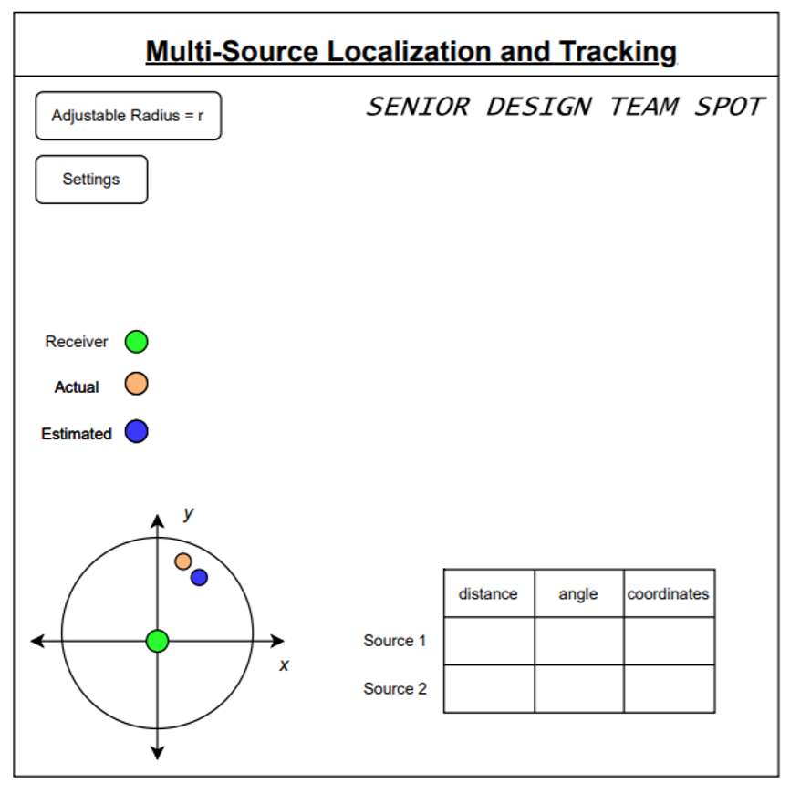
Project Demonstration
Video of working project
Will provide overview of GUI
Will test speech/acoustic signals
Will show successful tracking algorithm
GUI will show both actual and expected data

Slide 11


Schedule, Tasks, & Milestones

Slide 12


Cost Analysis
Requested budget for another Matrix Voice is $90
Collectively, about 20-25 hours per week for labor and research
  12 to 15 hours for research
  4 to 6 hours for algorithm development
  4 hours for GUI research and development
Cost of labor is about $800 to $1,000
  Used a laxed cost of $40 an hour

Slide 13

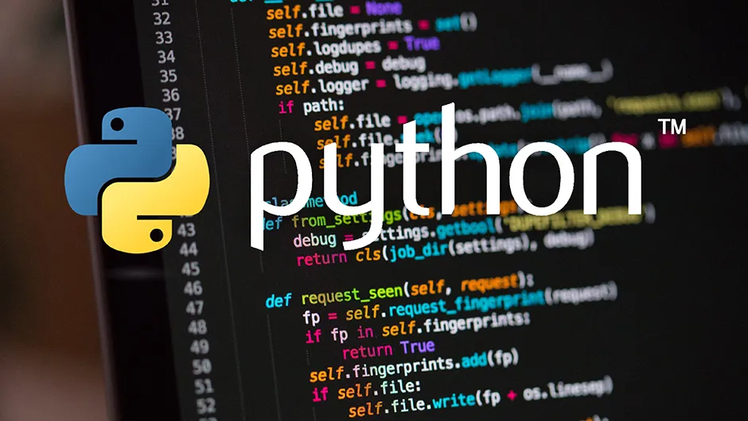
Current Status
Algorithm has been translated from MATLAB to Python
  Algorithm can be run repeatedly from executable
  Angle estimation has high accuracy
  RSS model training is
  Implement time difference followed by angle calculation.
  RSS model will be established.
GUI team is focused on adding features and interfacing with Algo
  Button Functionality has been established
  Graphing predicted vs real source location is next project goal

Slide 14



Leadership Roles
1. Tiffany Ho:
  Group leader
  Documentation Coordinator
2. Daniel Scarborough:
  Webmaster
3. Ajeetpal Dhillon:
  Documentation Coordinator
  Software/Algorithms Lead
4. Harry Nguyen:
  Financial Manager
5. Sidong Guo:
  Software/Algorithms Lead
6. Andrew Dulaney:
  Hardware Lead

