Slide 1
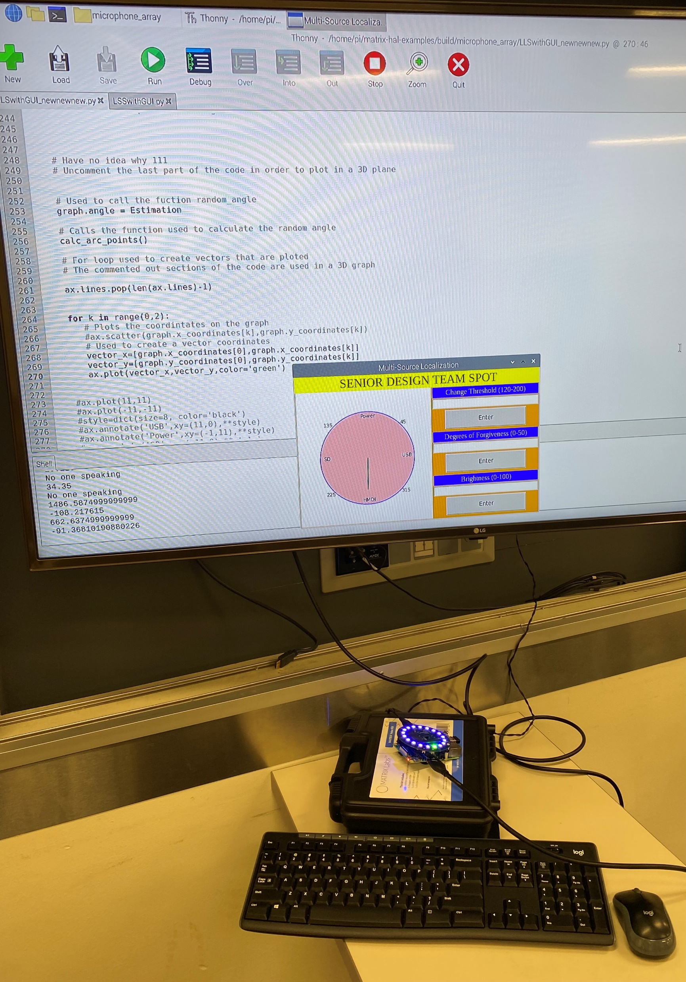
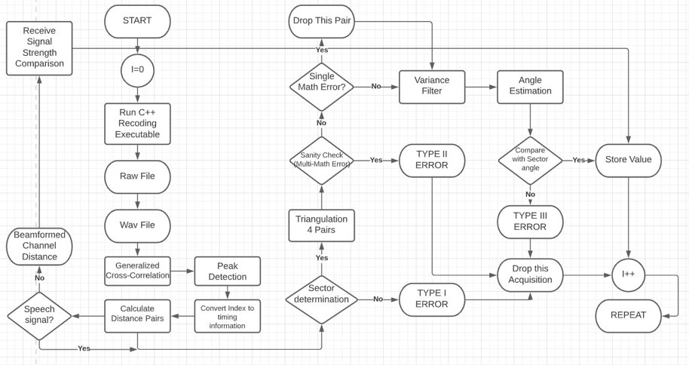
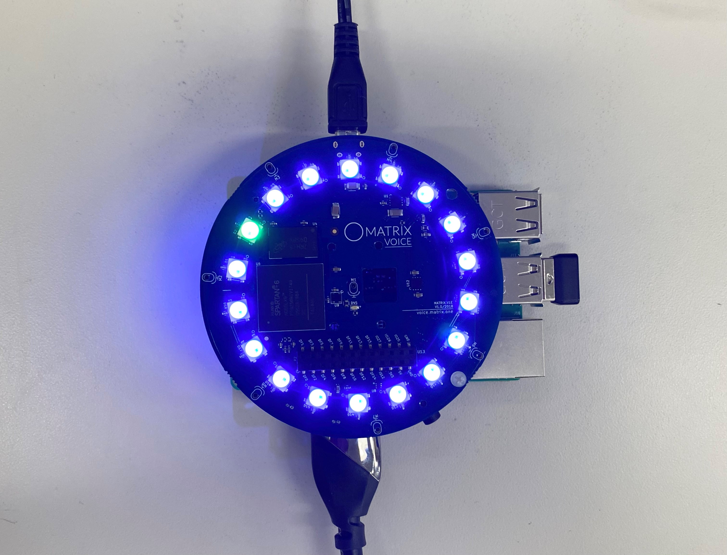
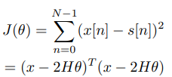
Acoustic Source Localization
Tiffany Ho
Ajeetpal Dhillon
Harry Nguyen
Daniel Scarborough
Sidong Guo
Andrew Dulaney
Introduction:
System Design:
Uses a microphone that detects the location of sounds.
Two main steps:
Time difference estimation
Triangulation
Biggest challenge:
Obtaining sound location information through multi-lateration.
Figure 2: Software Flowchart
Figure 3: Matrix with GUI on Monitor
Experiment:
Circular 8-microphone array is used to detect sounds.
LED lights on the array show the direction that the sound originated from.
Algorithm uses four sets of microphone distance pairs to triangulate the source.
Algorithm is run through a Raspberry Pi, which also feeds data back to the GUI.
Relevant Equations:
(1)
(2)
(3)
(4)
(5)
Figure 1: Original Matrix
Objective:
Create a software that can capture incoming sounds and the position of the sound will be reflected on the GUI.
Notes:
Spec must stay the same

