Slide 1
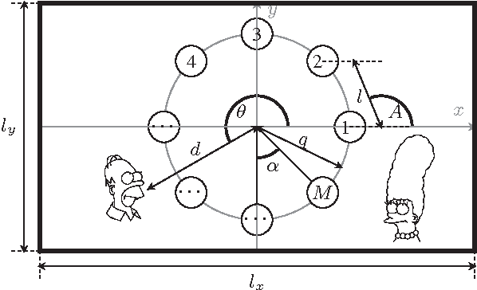
Acoustic Source Localization
By: Tiffany Ho, Ajeetpal Dhillon, Harry Nguyen, Andrew Dulaney, Daniel Scarborough, Sidong Guo

Slide 2
Introduction
Objective
To identify the location of a sound source in a given area.
Motivation
We would like to make an alternated detection method that offer an alternative approach to video detection.
Background
Different Methods
Time of arrival
Time difference of arrival
Receiver signal strength

Slide 3
Project Description
Localization Software for Acoustic Signals
Motivation
Applications in Emergency Rescue, child and elderly care
TDOA for Angle
Signal Strength for Distance

Slide 4
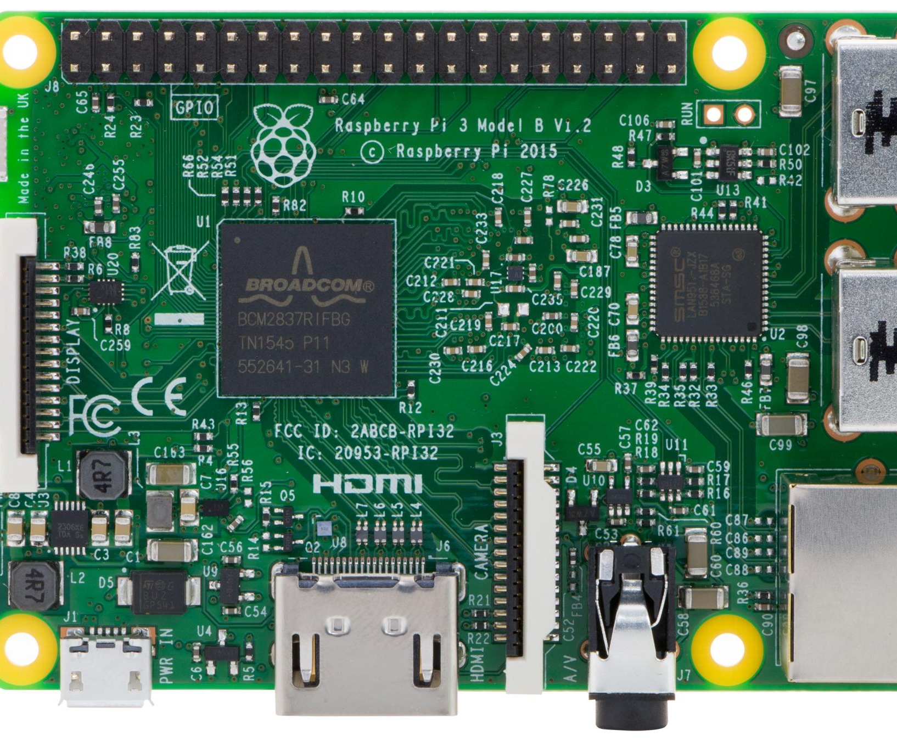
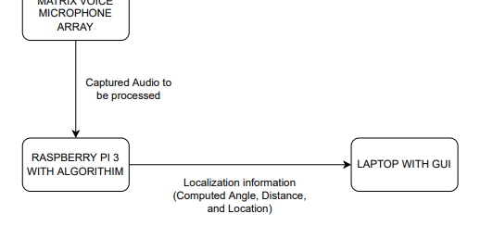
Design Details
MATRIX VOICE
Circular 8 Mic Array
RASPBERRY PI 3

Slide 5
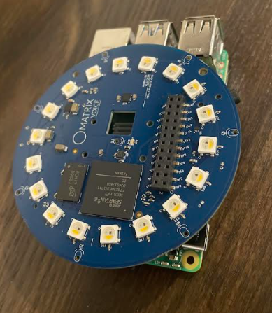
Raspberry Pi and Matrix Setup
Two functioning Matrix modules each with a Pi
Pi's can be 3 or 4
Buster OS
Matrix HAL Library
Localization.py
Runs recording executable via subprocess
Converts .raw files to .wav
Begins localization algorithm
Documentation on Setup

Slide 6
Design Specification
Parameters | Specifications
Audio Specification | 8-96 kHz
Bit Depth | Signed 16 bits
Operation Range | 20 meters
Cost | Below $200
Angle Accuracy | Average difference within 3 degrees
Distance Accuracy | Average difference within 30 centimeters
Processing Delay | Average processing delay within half second

Slide 7
Software Flowchart

Slide 8
Angle and Distance Calculation
Use multi-condition if statement that compares 4 sets of microphone distance pairs to determine the sector of the source
Calculate 4 angle estimation based on triangulation
Apply sanity check on angle estimates and drop any error estimates, if more than 2 errors are made in 4 angles, drop this acquisition
Apply variance filter to filter outliers, store the angle value
Distance calculated based on RSS, store the RSS value
Ensemble mean averaged over 5 acquisitions in short time period and output the coordinates
Start again for next set of coordinates

Slide 9
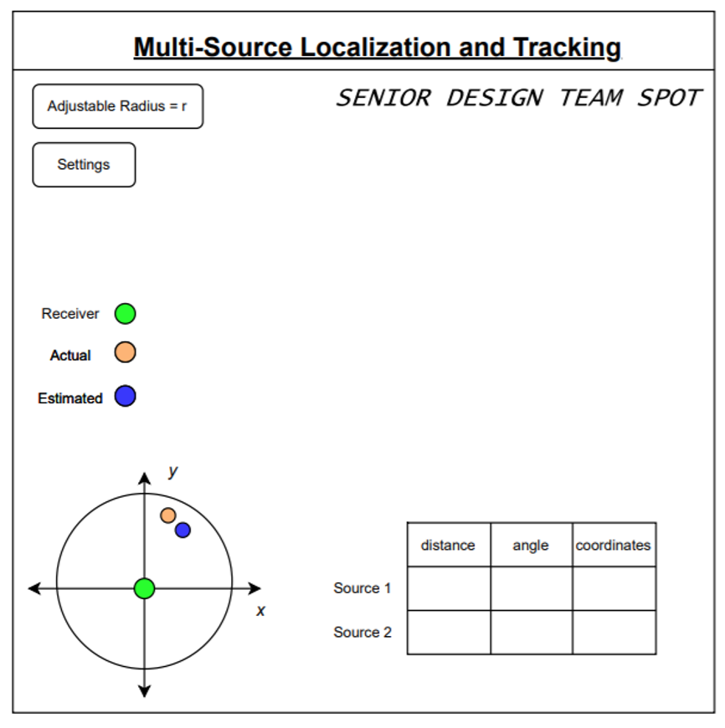
Project Demonstration
Demo of working project
Video for back-up
Will show an overview of GUI
Will test speech/acoustic signals
Will show successful tracking algorithm
GUI will show both actual and expected data

Slide 10
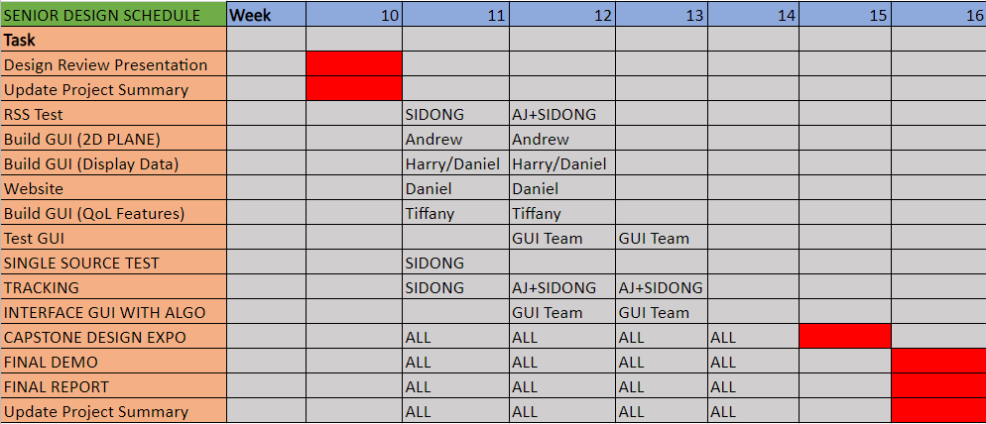
Schedule, Tasks, & Milestones

Slide 11
Cost Analysis
Received the Matrix Voice at the cost of $90
Collectively, about 20 hours per week for labor and research
10 hours for research
6 hours for algorithm development
4 hours for GUI research and development
Cost of labor is about $800 to $1,000
Used a laxed cost of $40 an hour

Slide 12
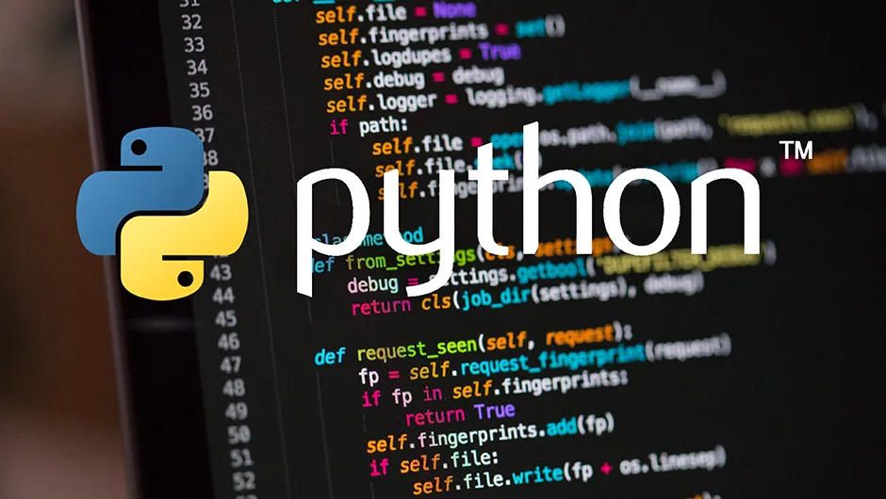
Current Status
Algorithm has been translated from MATLAB to Python
Algorithm can be run repeatedly from executable
Angle estimation has high accuracy
RSS model will be established.
GUI team is focused on adding features and interfacing with Algo
Button functionality has been established
Graphing predicted vs. real source location is next project goal

Slide 13
Leadership Roles
1. Tiffany Ho:
Group leader
Documentation Coordinator
2. Daniel Scarborough:
Webmaster
3. Ajeetpal Dhillon:
Documentation Coordinator
Hardware/Software Lead
4. Harry Nguyen:
Financial Manager
GUI Team Lead
5. Sidong Guo:
Software/Algorithms Lead
6. Andrew Dulaney:
Lead for graphing options on GUI

